Slide 1
How to plot a linear graph using Excel
*Please note that the instructions may change slightly depending on whether it is an on-line or a desktop Excel application. It will also depend on the Microsoft Office version you are using on your device.

Slide 2
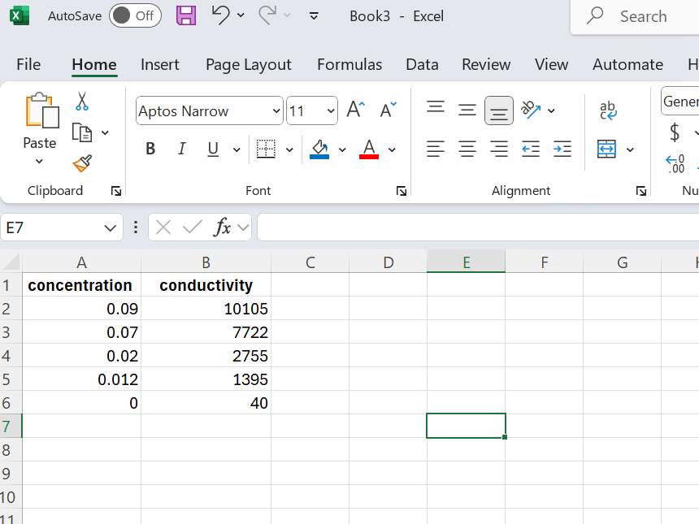
How to start
Open a new Excel workbook
Enter your x values in column A and the corresponding y values in column B side by side
Note that in some Excel versions, a default setting might be rows not columns for data entry, i.e. the program might take all the values in the first row as x-values and all the values in the second row as y-values.

Slide 3
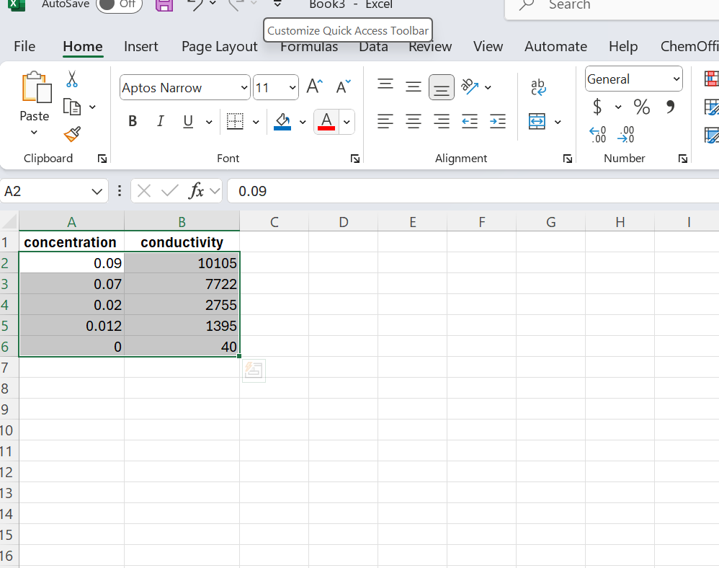
Select your data

Slide 4
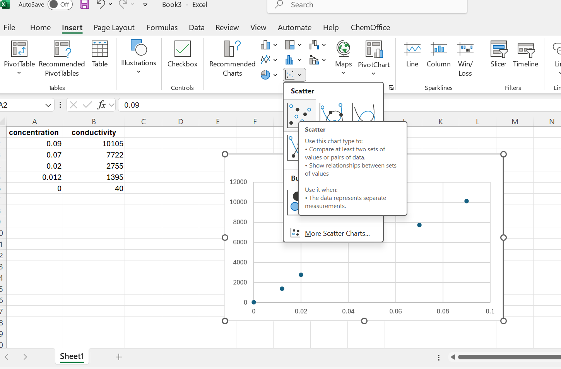
Choose a graph type
Go to: Insert/Recommended Charts/Scatter
For Gen Chem Labs you will only mostly use Scatter option for your graph plotting

Slide 5
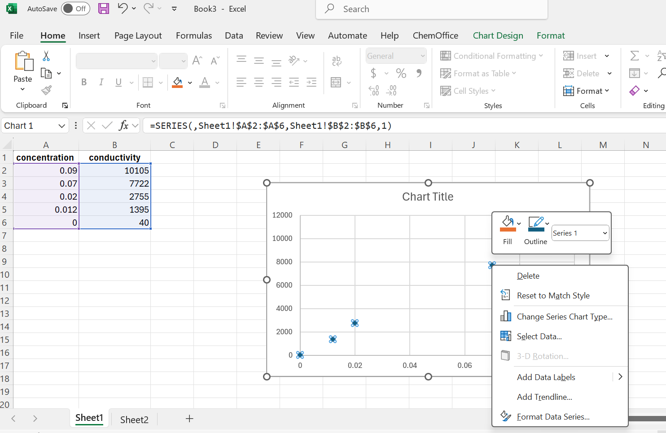

Editing your graph
Position your cursor on one of the data points on the chart and then right-click.
A new drop-down menu will appear
Click on “Add trendline”

Slide 6
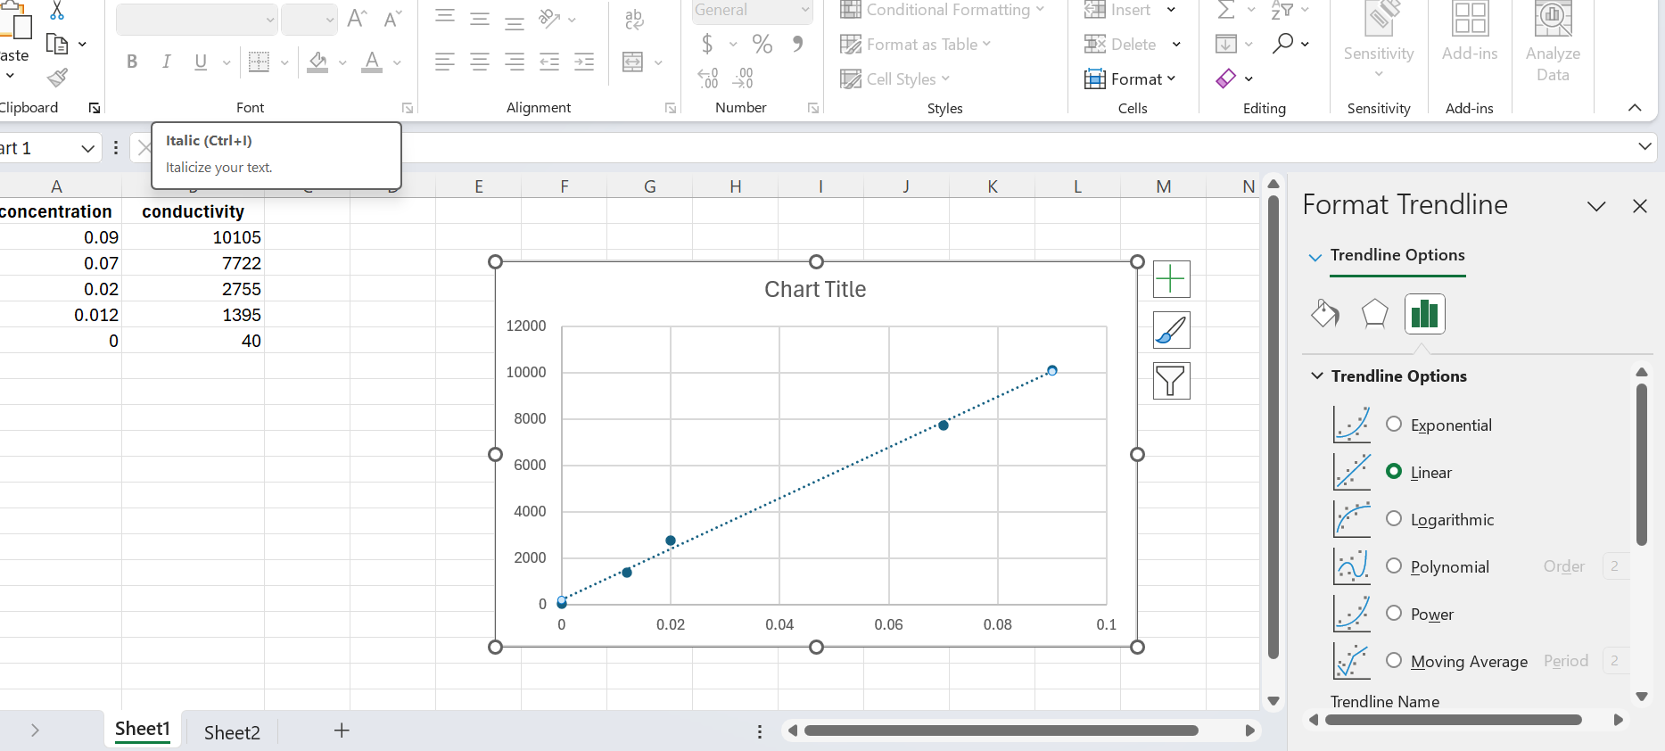
Formatting Trendline
A trendline will appear as well as a new menu on the left
Scroll down the Format Trendline menu on the right to add the equation and the R² value

Slide 7
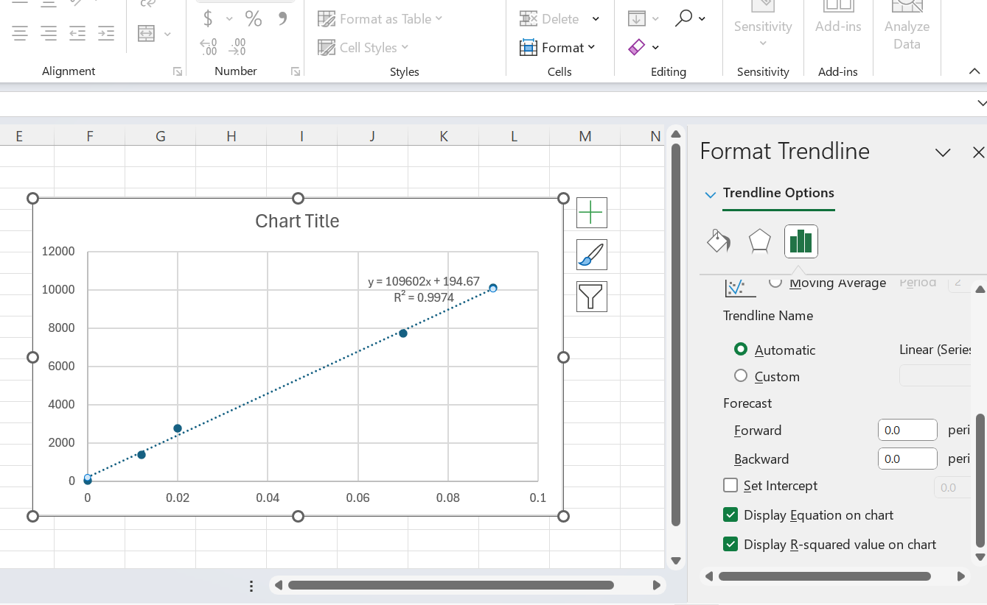

Adding the equation and the R²
Click on “Display equation on chart” and “Display R-squared value on chart” to display your linear equation formula and the R² value

Slide 8
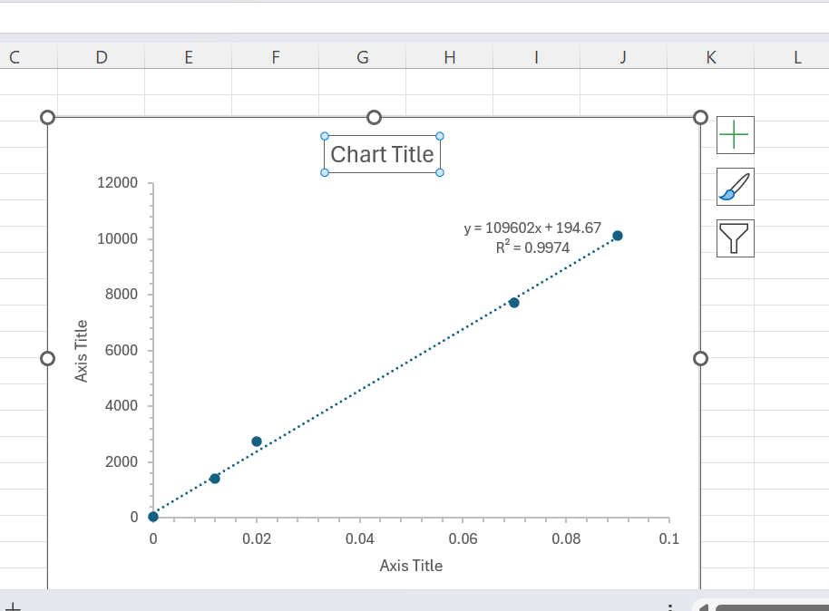
Formatting the chart title
Left-click on the “Chart Title” to edit your title

Slide 9
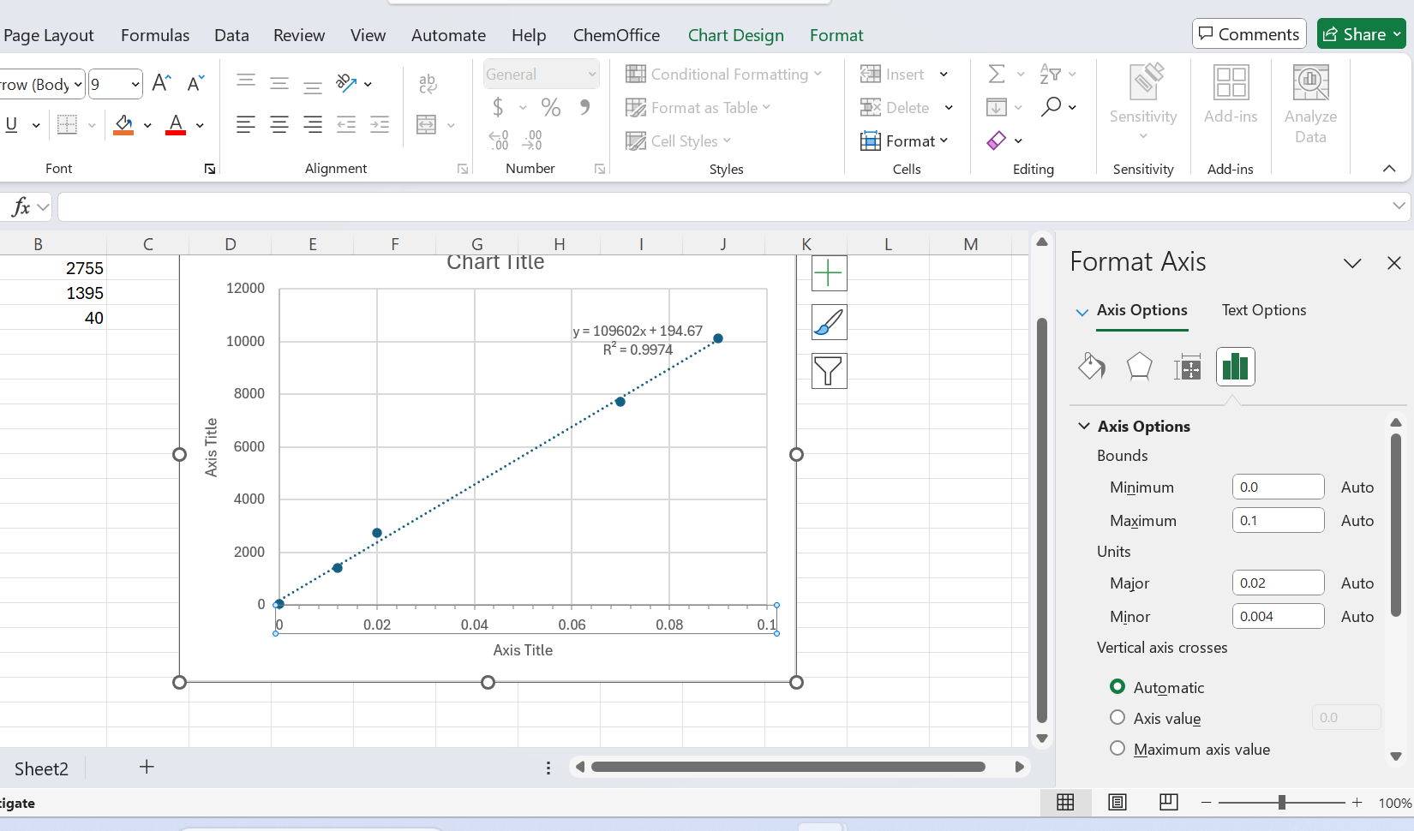
Formatting the axis
Right-click on the x values on the x axis to format the axis

Slide 10
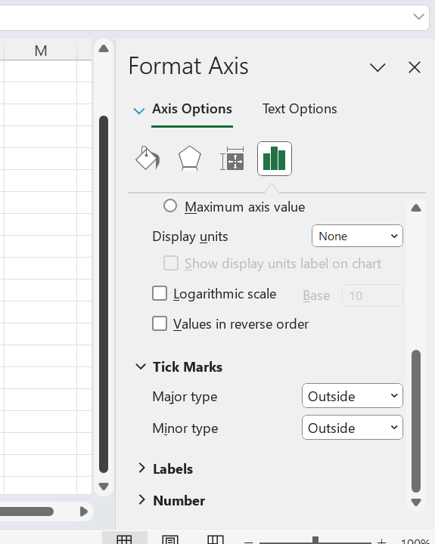
Formatting the X-axis
Scroll down the menu on the left to activate the tick marks. You can choose either Outside or Inside tick marks
Now do the same with the Y-axis

Slide 11
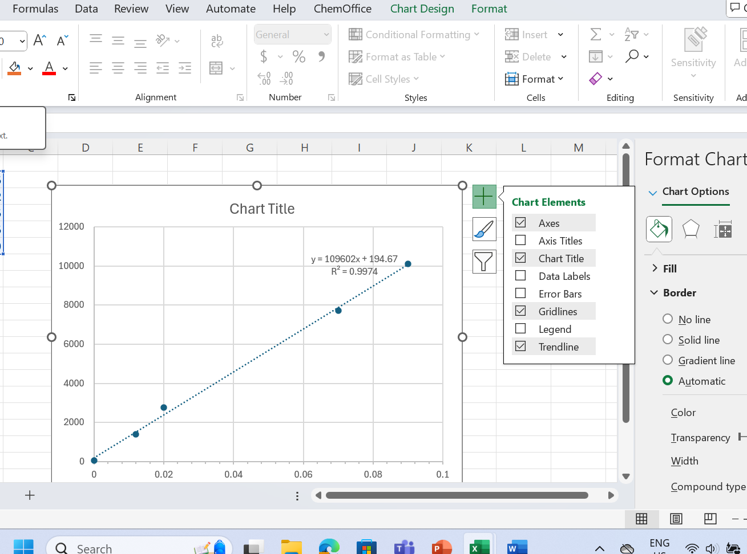
Adding chart elements
Left-click on the graph window and then click on + sign in the top right corner to access the Chart Elements Menu

Slide 12
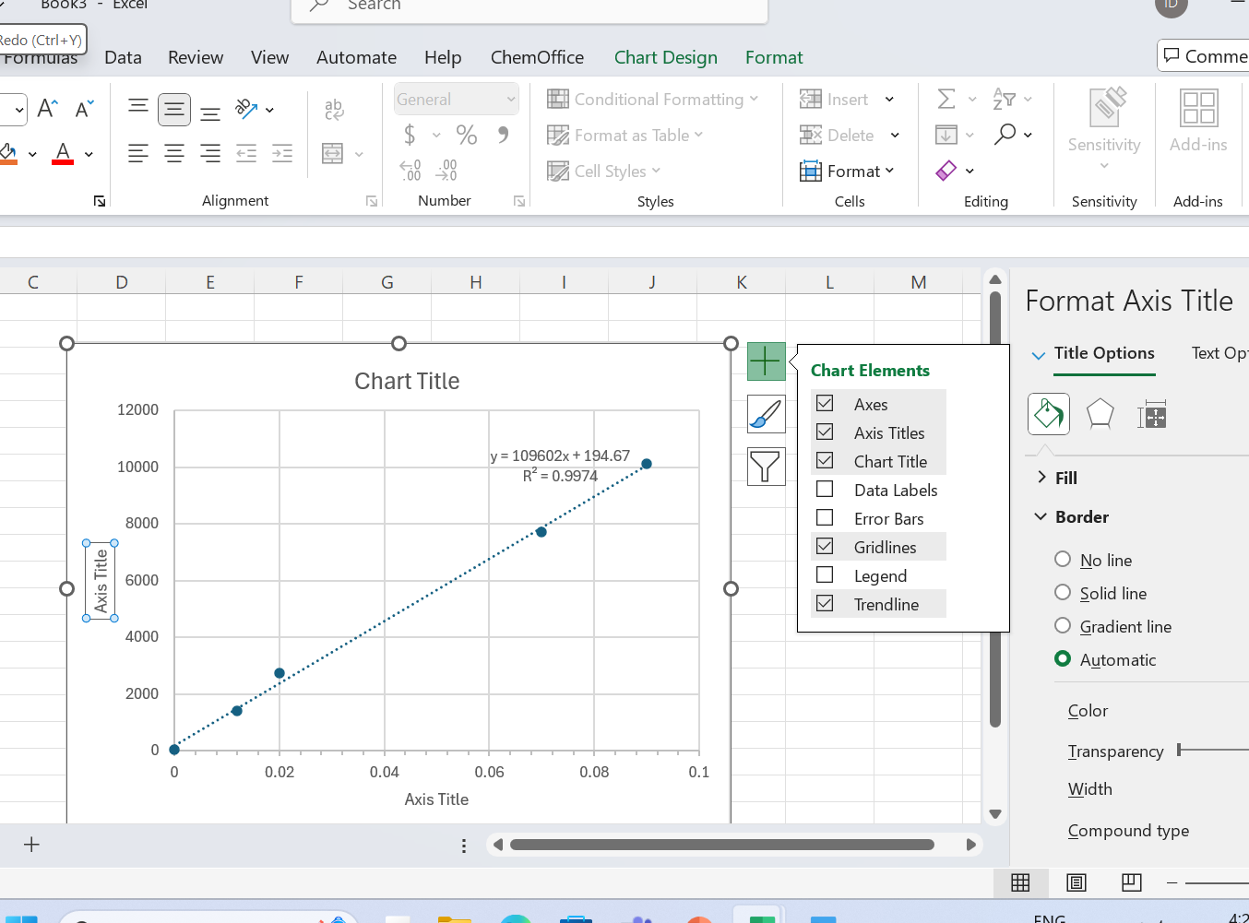
Adding axis titles and removing the gridline
Choose Axis Titles to add titles
Deselect the Gridlines

Slide 13
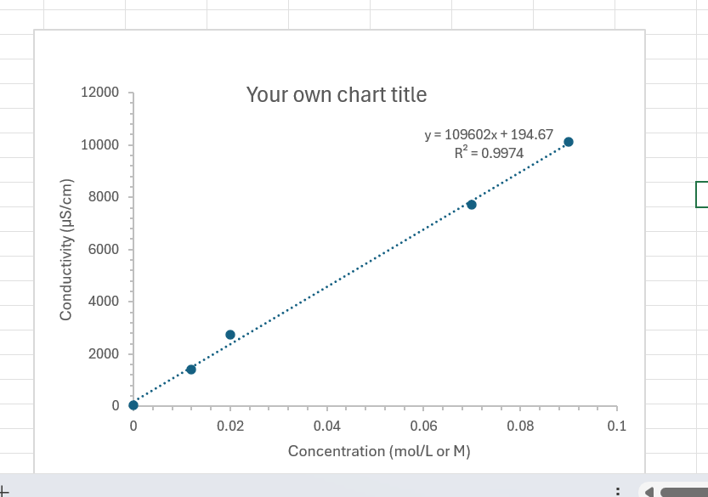
Final product

Slide 14
Graph requirements:
A title for the graph –should be brief but comprehensive. Do not use Conductivity vs Concentration as a title.
Titles for the axes – contain units
Trendline – dotted line
Equation – present on the graph window
Tick marks – present (Inside or Outside are both accepted)
Correlation (R²) values – present next to the equation
Gridline - removed
Graph - well centered and occupy most of the space

